Slide 1
AMAC
1
ALLEN MAGNETIC ASSIST COUNTERBALANCE MACHINE
WHITE PAPER
JASON ALLEN – JASON@INAGIANT.NET SEPTEMBER 2 2023

Slide 2
TABLE OF CONTENTS
INTRODUCTION
COMPONENTS
HOW DOES IT WORK?
ADVANCED GENERATOR SOLUTION
USE CASES - POWER STATION, DECENTRALISED HOME POWER GRID, ELECTRIC CARS – UNLIMITED RANGE
CONCLUSION
AMAC

Slide 3
INTRODUCTION
This AMAC machine design was created to address the need for an energy creation system that could solve the perceived impossible effort to create more energy than was consumed, traditional energy systems such as fossil fuels, nuclear, wind, solar and tidal systems are either damaging to the environment or require complex development and management to prevail.
The world needs more electricity but carbon is heating up the planet causing records to be broken and devastation for all life.
We are all aware and it is heavily documented so this design has been made open source, free to use and modify to create even more efficient systems but it would be appreciated if the label of AMAC be used in any product created, even for one man’s insignificant ego.
I have also listed Use Cases that may be of benefit for the future, thank you David Attenborough, this is for you and the reason I made it open source.
What is shown in the next few pages uses multiple natural physical forces rather than a single jigsaw piece but the idea remains completely simple, so simple in fact that it would be cheap to build en masse with the minimum of resources.
Thank You, Jason Allen – Designer of the AMAC

Slide 4
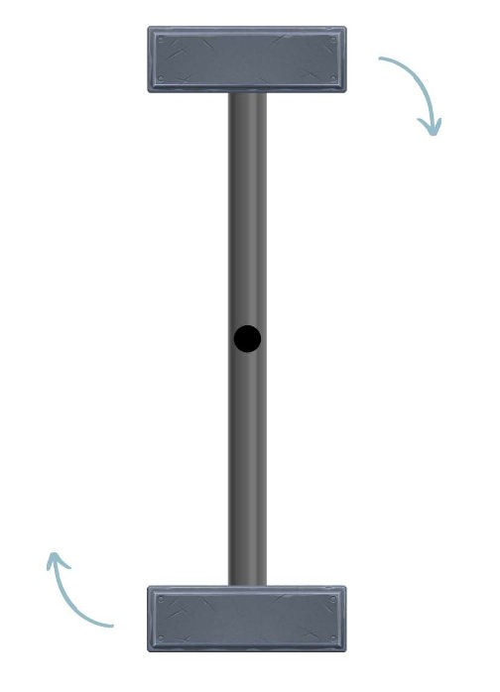
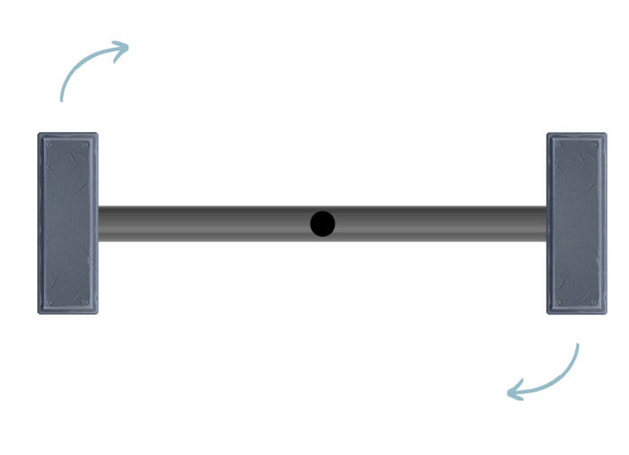
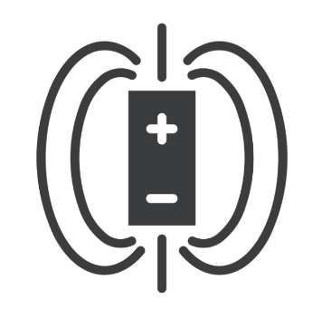

COMPONENTS
The Components…(I will explain the process after this section)
1. Balanced Counterweight
A counterweight that spins on a central pivot point, both weights are equal, as the weight revolves around its gravitational pull sends it into a rotational fall, creating momentum and kinetic energy in the process, on its own it may complete 1 or more rotations but eventually it will slow and settle into a horizontal position of balance
2. Magnetic Line for repulsion
All magnets have a positive and negative polarity, if you for example stack them together you find that one end will be positive and the other end negative, for this design I have stacked them together in a line.

Slide 5
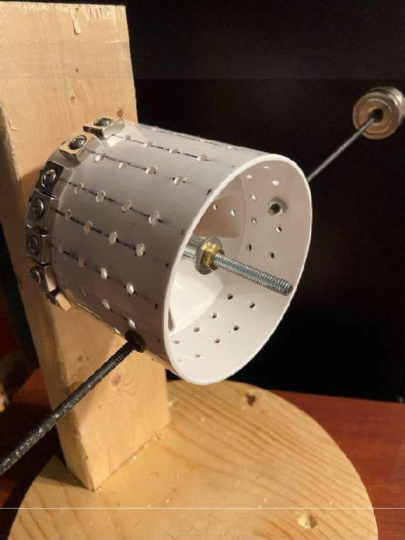
A second stronger magnet is also used in the process together with alternative methods of movement such as piston, gears or electromagnet. This is connected to a separate frame.
3. Revolving Drum
The drum will be thin in width with the attached counterweight and magnet lines for each part of the counterweight, I created a simple prototype for this as a test, it spins on a central bearing which is also the central pivot point for the counterweight.

Slide 6
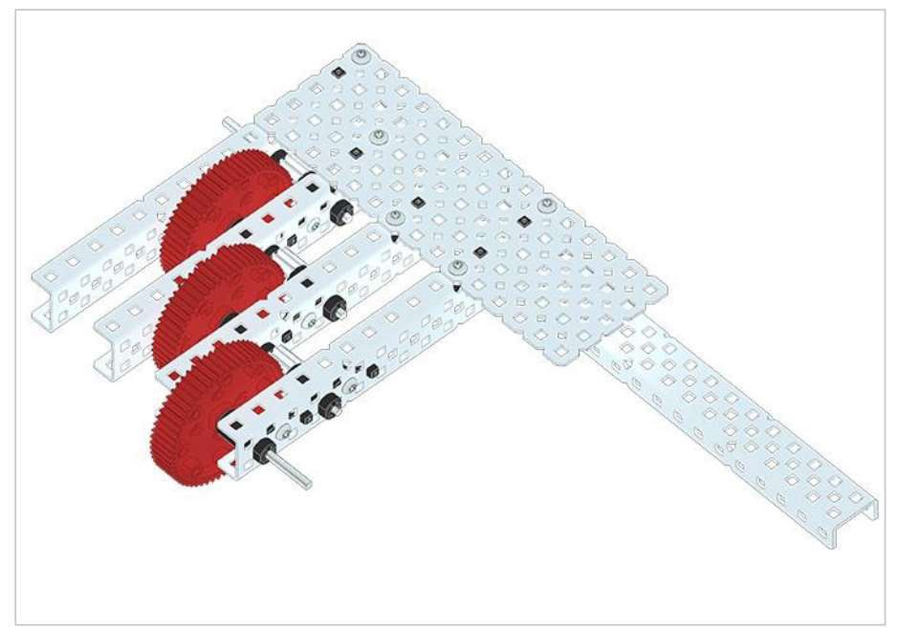
4. Mechanical Advantage Gear Set
Example Source Link: https://education.vex.com/xyleme_content/mechanical- advantage/pdf/mechanical-advantage.pdf
Seen here is a smaller example of a gear set that allows one rotation of the first driving gear to translate into several rotations of the final driven gear, although in this example the gears are the same size but below explains what happens to different sizes. The example above illustrates an example of a gear system for this AMAC design to move a generator spindle.

Slide 7
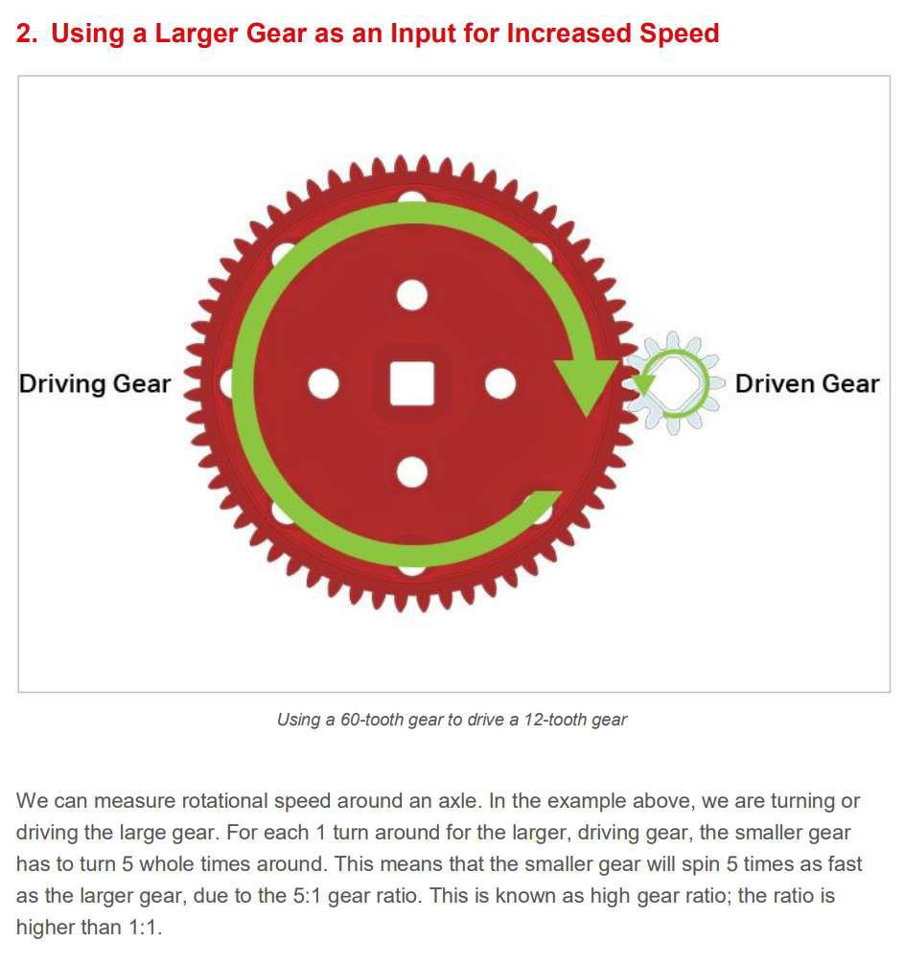
Mechanical Advantage allows us to rotate at a ratio dependent on the combinations of gears and parallel connections. For example a ratio of 1:125. The number of teeth on each gear is also part of that determination.

Slide 8
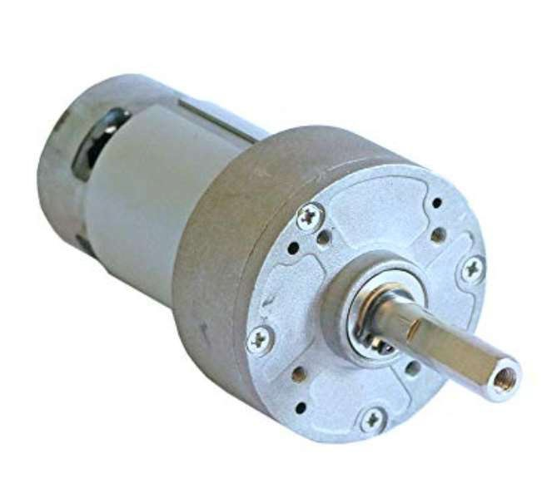
5. Generator
The final piece of the puzzle is the generator itself, there are numerous examples, one I have been using is an Italian made Makemu 300Watt Step Up Generator – a Wind Turbine, it has its own gearing inside the housing that is a 1:12 gear ratio. You pick the generator for your planned product. Note the spindle that requires torque to turn.

Slide 9
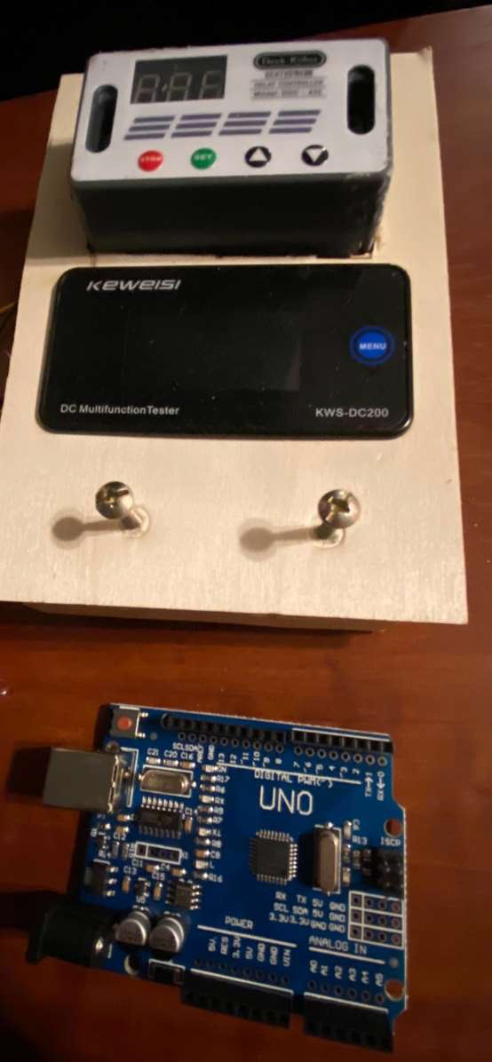
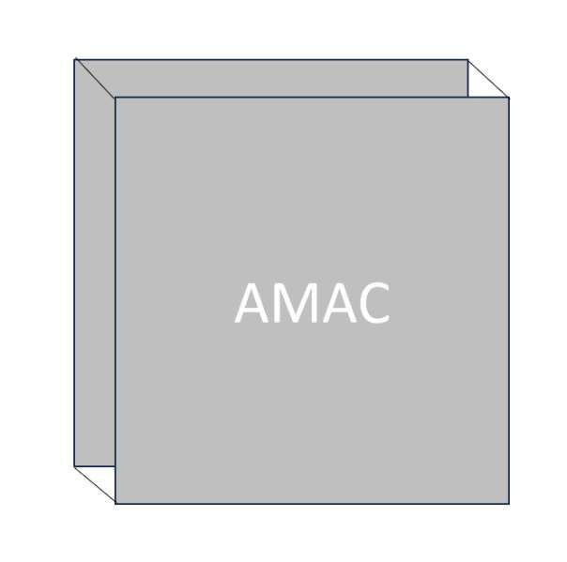
6. Casing, to include electrical power management systems
A casing can be thin enough to house all of these components if arranged correctly including any electronics, even for example an Arduino processor and power output meters and delay controllers.

Slide 10
HOW DOES IT WORK?
With all of the components together this is the process…
The counterweight begins its rotation, which is attached to the revolving drum on the central bearing, attached to a frame within a casing
Gravity will affect the top weight and both weights will rotate around the central axis, creating kinetic energy and torque.
A line of magnets fixed to the drum near the base of the pole that holds the top weight will move in motion
A larger magnet which matches the polarity of the trailing end of the magnet line will
move into place just as the trailing end appears (it isn’t fixed on the drum but on a separate frame), this creates a large magnetic repulsion effect which will increase the speed of the top weight, now further down and in free fall, enabling it to gain even more momentum.
The bottom weight has now reached the top of the drum and passed it to the point that gravitational force will affect it also, a tipping point as it were, and it will fall in exactly the same way as the original top weight.
A perpetual cycle has occurred, the casing as a note could also be vacuum sealed to remove air that may affect its motion (Wind for example).
At the central point where the bearing sits would be a spindle that turns the mechanical advantage gears using a large torque force from kinetic energy, coupled with the counter weight. In other words, the counter weight determines the torque, the pole length also, as well as the gear combinations. All can be calculated.
The gears would rotate the spindle of a generator, in the example I have having a 1:12 gear ratio it is even more efficient in electricity generation.
Note that in point 4, there can be various ideas in play here, for example an electrically sequenced piston to move the larger magnet into place just as the repulsive magnet line appears (perhaps a hole light sensor or delay controller).
Another example could be a timed gear that moves when the central spindle moved inside the drum to mechanically move it into place.
A further example could involve a wound copper wire around iron, nickel or cobalt to deliver a charge in sequence using a delay controller or programmed Arduino or other electronic device, this would mean that the metal core can be fixed in place requiring no mechanical movement

Slide 11
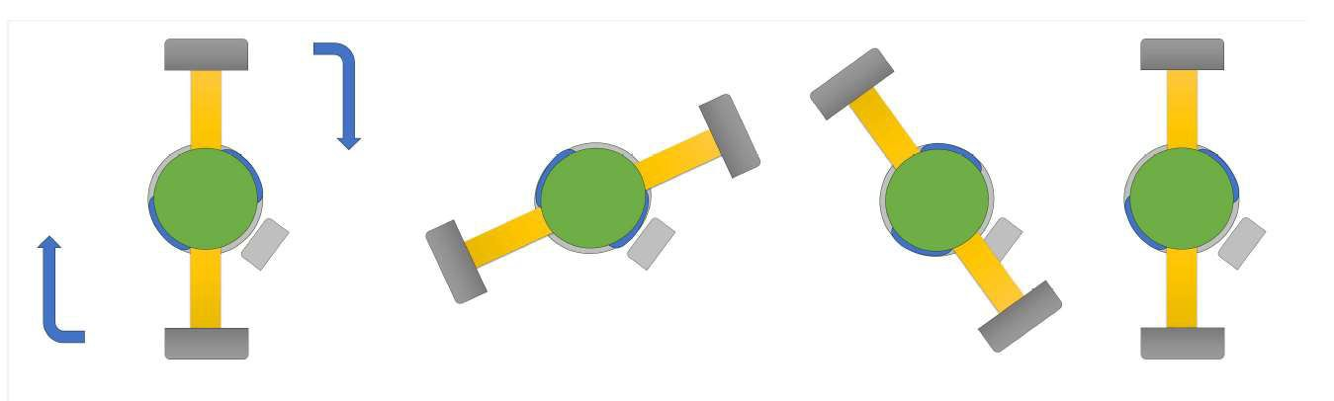
or gearing. It would use a small portion of the electricity generated by the counter weight and gears. In this scenario a battery is likely for storage and recharge.
This is the complete idea, very simple, almost too simple but a device that would create more energy than it consumes!, the holy grail of energy production.
Rotation example.
The physical forces in play overall are gravitational, magnetic repulsion, kinetic energy, torque and mechanical advantage, this is the key to AMAC.
Note on Perpetual motion…
There is only perpetual motion as far as the components do their job and do not fail but they will eventually for example the bearing, gears and electronic components.

Slide 12
ADVANCED GENERATOR SOLUTION
An electromagnetic induction motor could be used where a current is induced by moving a magnet within a coil or the coil over a magnet.
You could eliminate the need for increased torque to move a generator spindle in this case, here is a link to examples…
https://www.embibe.com/exams/electromagnetic-induction/

Slide 13


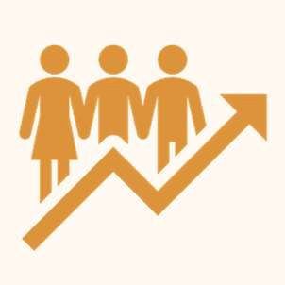
USE CASES
USE #1
Power Station
USE # 2
Decentralised Home Power Grid
USE #3
Electric Cars with unlimited range

Slide 14
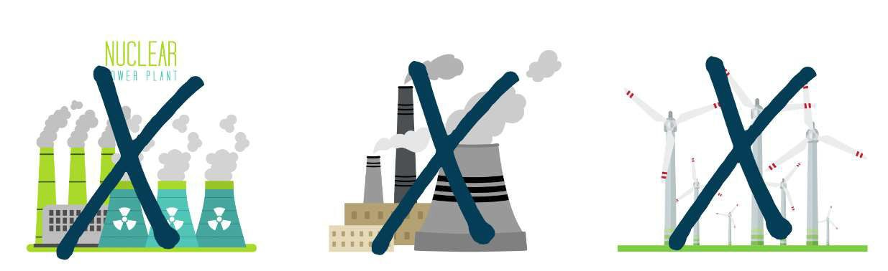
USE CASE #1
POWER STATION
The advantages are obvious, no nuclear fuel, no harmful carbon emissions from burning fossil fuels and no expensive arrays of wind turbines on landscapes with a known shelf life.
Imagine a scaled up version of the case, or multiple large cases for redundancy measures.
The device would be 100% carbon neutral, produce minimal heat from bearing and gear movement plus generator rotation but it has no heat comparison at all to the nuclear or coal/gas powered plants.
Wind Turbines only work in sited areas where wind is strongest and vary on wind availability each day, they are also very costly and sited in areas of outstanding beauty

Slide 15
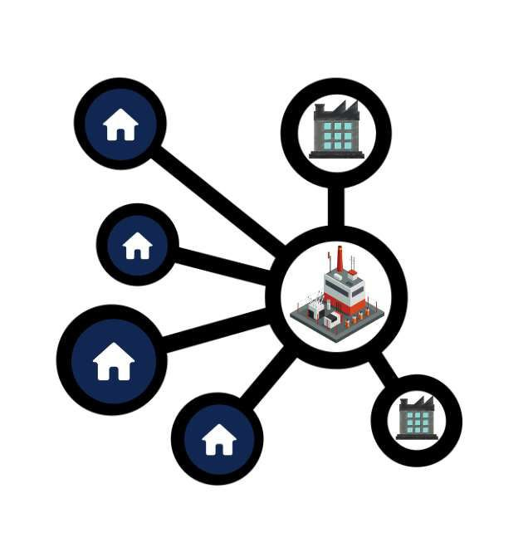
USE CASE #2
DECENTRALISED HOME POWER GRID
Imagine a world where a household would rent an AMAC power case, sited in the yard, connected to the existing grid infrastructure, for example a 6kwh unit, any excess electric not used at any time would flow back into the grid to be managed by the power company. The electric generated by the unit would be free.
The power company would then sell electricity generated by masses of households to businesses at a very reduced rate. There is also the possibility of businesses having their own.
The power to the home would be power cut free, in the event of a natural weather incident, but in the case of power loss to the home electricity could be provided by the power company at a fee for a backup before repair or replacement.
The benefits of always on are too numerous to list but a few examples could be medical needs and food preservation. Other uses could be crypto mining that takes away a strain on the central grid and a security advantage in case of conflict.

Slide 16
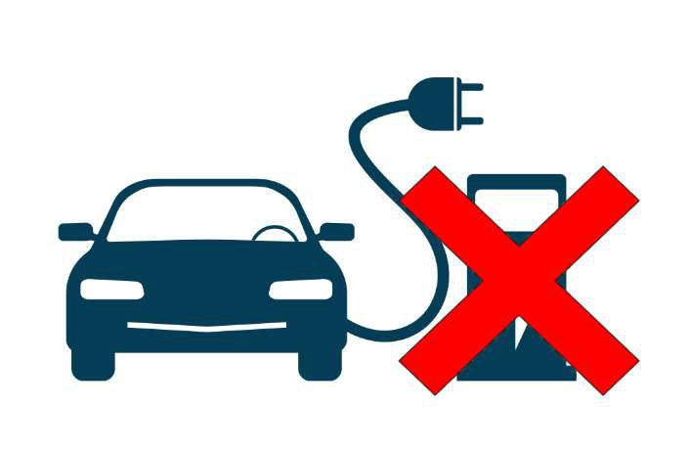
USE CASE #3
ELECTRIC CARS
With the growing demand to replace gas and diesel cars and for some countries policies to restrict sales of new cars to electric only it goes without saying that every country is facing an infrastructure crisis to keep up with demand and future use.
Land required for charging stations, expensive home chargers, limited resources for large scale lithium battery production etc
Now consider an alternative vision, imagine an engine bay much like a giant PC printer head where ink cartridges are inserted, then insert 4 AMAC cases, 1 for each wheel motor, have an ON DEMAND power supply system that uses power whenever the car is in motion rather than a bank of lithium batteries to supply power, thus requiring a recharge.
A typical car uses 0.3Kwh per mile, why not provide it on the go AND NEVER RECHARGE!
If one AMAC unit should fail then there would be enough power from the others to divert energy, if a wheel motor fails then the other wheels would continue to work as they are all independent.
Service stations could continue to provide standard AMAC units to vehicles, perhaps upgrades or replacements for faulty units, spare wheel motors etc.

Slide 18
CONCLUSION
As the design is Open Source, I hope that you will produce a huge variety of enhanced designs, more efficient designs, positive use cases to benefit the planet and all of its inhabitants. Share ideas, create forums and connect. It really is the most important time for action. Thank You.
Jason Allen

